Slide 1

Industry Training
SME
Notes:
Main Title Page

Slide 2
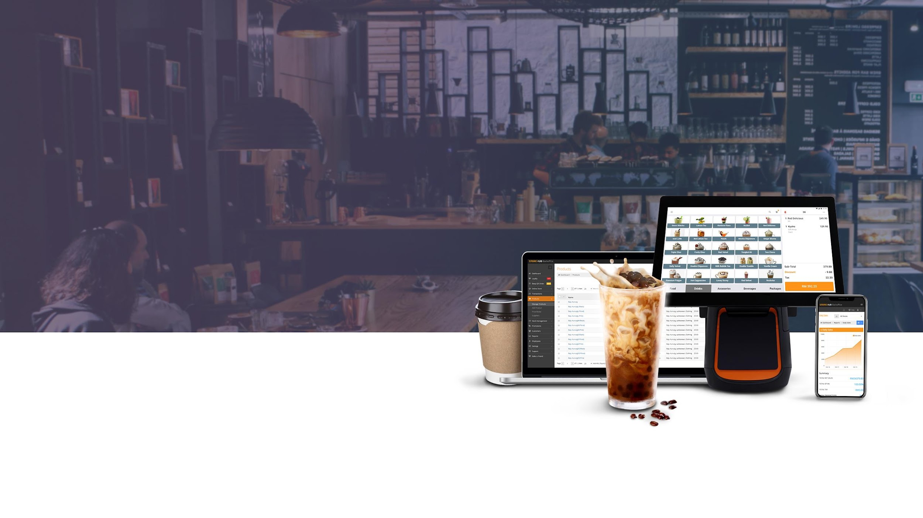

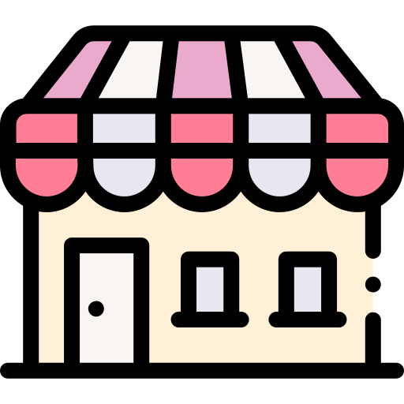
Small Medium Enterprise (SME)

Slide 3
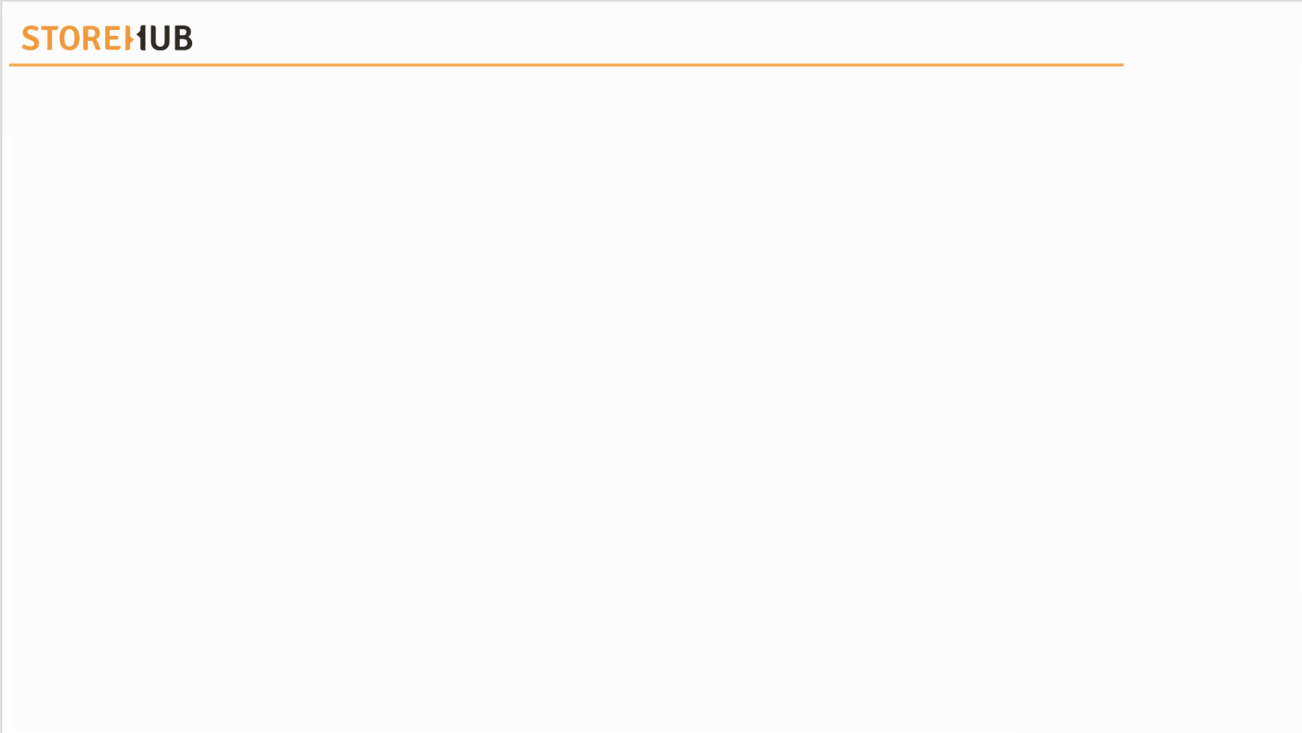
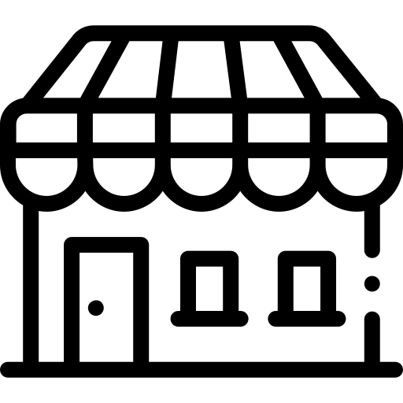


| Small Medium Enterprise (SME)
Types of SME
Retail
Types of SME
Food & Beverages
(F & B)
Services

Slide 4

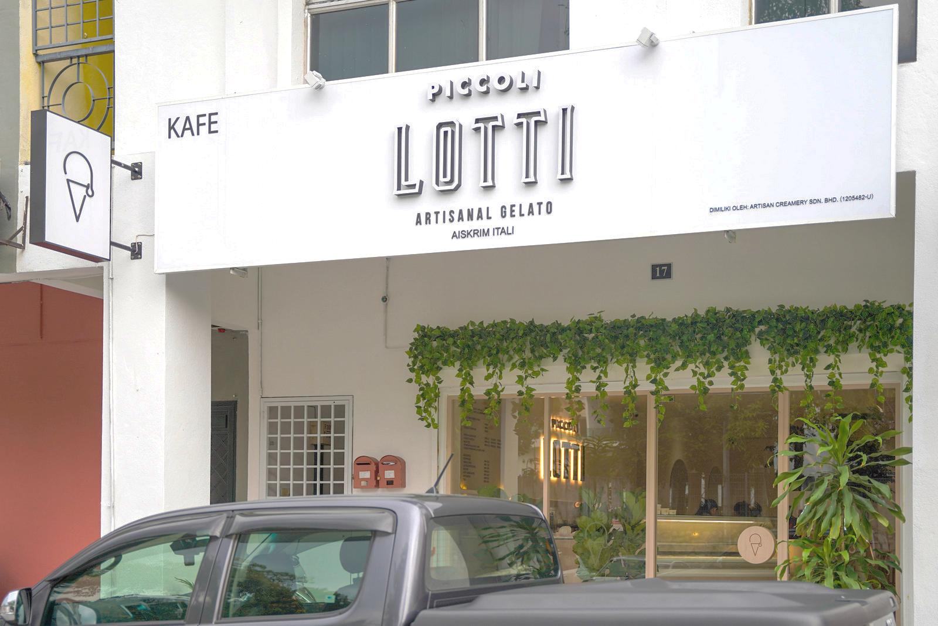
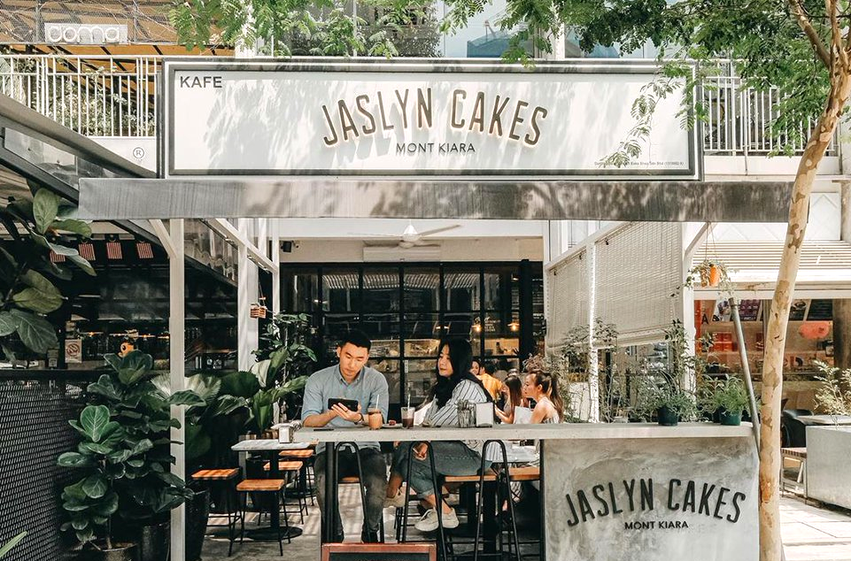
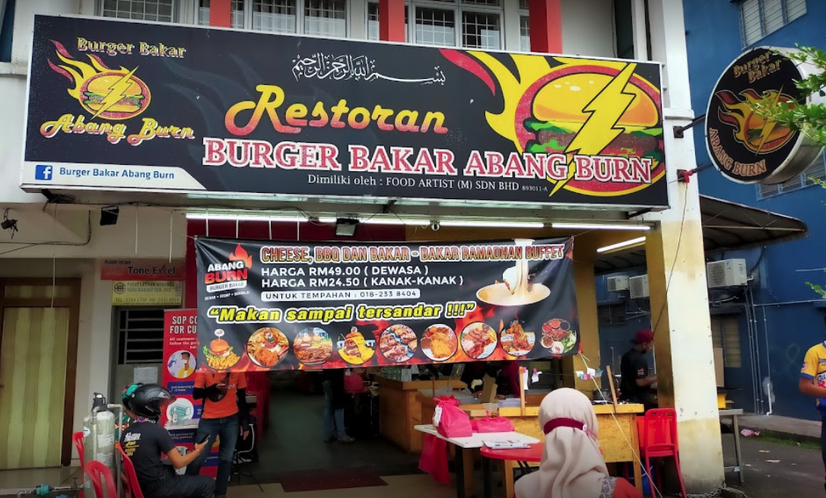

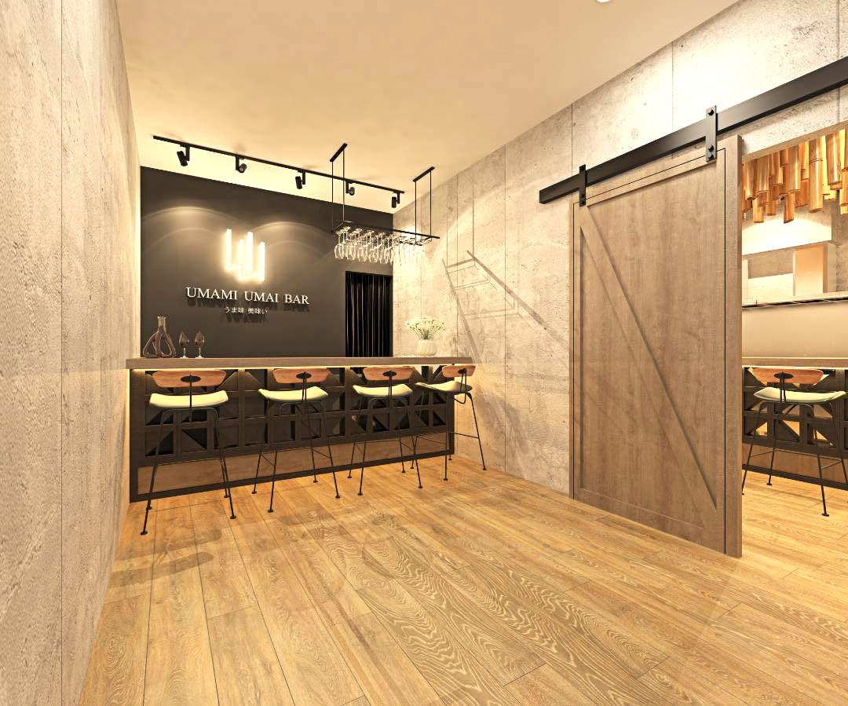
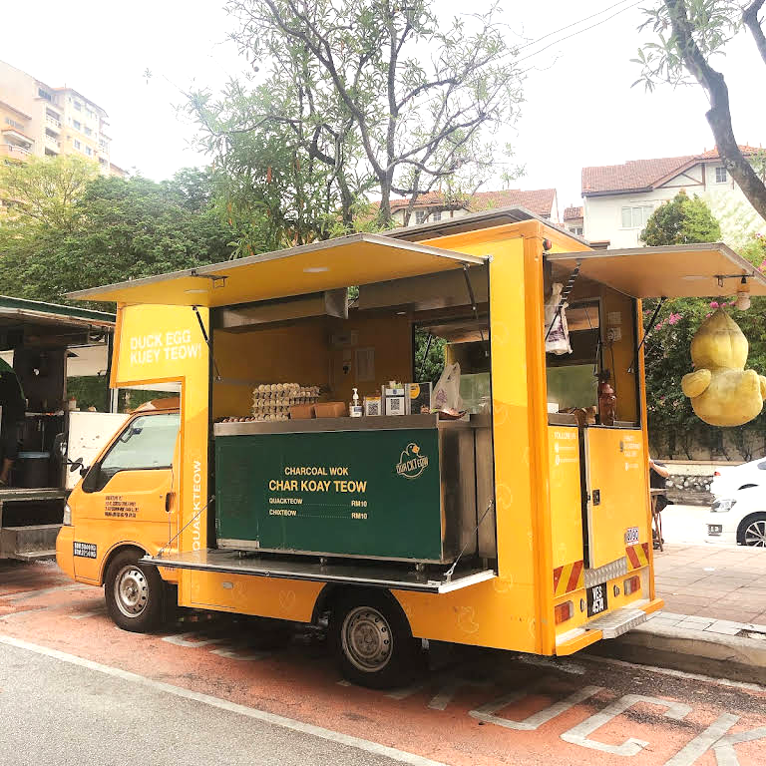
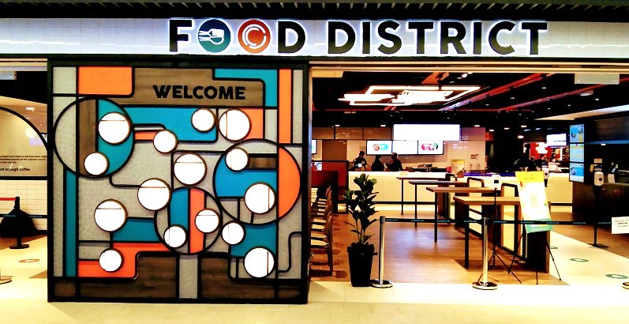

| Small Medium Enterprise (SME)
Food & Beverage (F&B): Overview
The food and beverage industry encompasses all businesses involved in the processing, packaging, and distribution of food.
This category encompasses both fresh and packaged foods, as well as alcoholic and non-alcoholic beverages.
Examples of different F&B merchants using StoreHub:
Quick-Service
Cafe
Restaurant
Bar
Food Truck
Food Court

Slide 5





| Small Medium Enterprise (SME)
Food & Beverage (F&B): Profiling
What is “Quick-Service”?
Pain Points
Quick-service restaurants (QSR) provide customers with convenience, speed, and basic services at lower prices.
Customer usually would need to pick up their food with que numbers.
Fewer employees (only behind kitchen & cashier).
Scenario / Example:
The QSR only has two waiters and is still using the old POS cash register. Both of the staff manage the orders and prepare the food. It takes 10 minutes to complete an order for each customer. During peak time, customers would tend to wait longer to get their food, and the queue will be long. Therefore, there would be many complaints from the customers.
Long queue.
Old POS system.
Waiting period.
Fewer staff.
Can’t keep up with rapid-fire orders.
Solutions
QR Order & Pay
Queue number auto generated (BO).
Beep Delivery.
Recommended POS: iMin Falcon 1 | Sunmi D3/| iPad
Supplementary Devices : Cash Drawer, External Printers, Router
POS = Point of Sales | BO = BackOffice | QR = Quick Response | QSR = Quick-service Restaurant
Notes:
MY- One Piece Onigirazu
PH- Happi Lee
TH- Onisan oden sriracha

Slide 6



| Small Medium Enterprise (SME)
Food & Beverage (F&B): Profiling
What is a “Cafe”?
Pain Points
Cafe is a type of restaurant which typically serves coffee & tea, in addition to light refreshments such as baked goods or snacks.
Customers would usually need to order at counter / at the table & be seated to get their food or drinks served.
Scenario / Example:
The cafe has 12 tables with 3 staff. Each staff member handles the kitchen, cashier, and the customers' orders. Customers need to wait for at least 30 minutes for their food, and the staff can only engage a little with the customers when it is full house.
Fewer staff.
Customer management.
Long waiting period.
Solutions
QR Order & Pay
Membership
Beep Delivery.
Recommended POS: iMin Falcon 1 | Sunmi D3/| iPad
Supplementary Devices : Cash Drawer, External Printers, Router, Bixolon Printer (if needed)
POS = Point of Sales | BO = BackOffice | QR = Quick Response
Notes:
MY- Emilyn’s cafe
PH- Cafe Dionysus
TH- ดงดิบ (Dngdib)

Slide 7
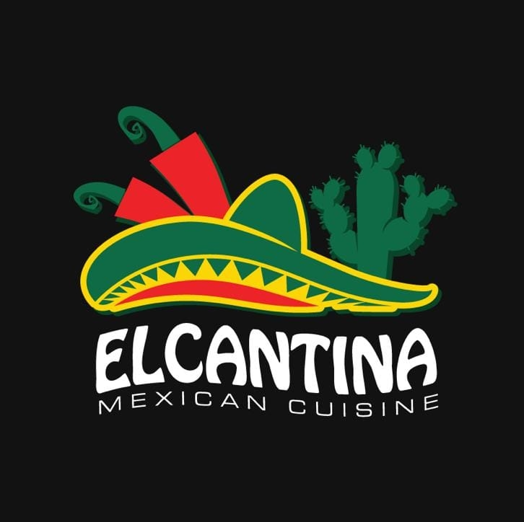
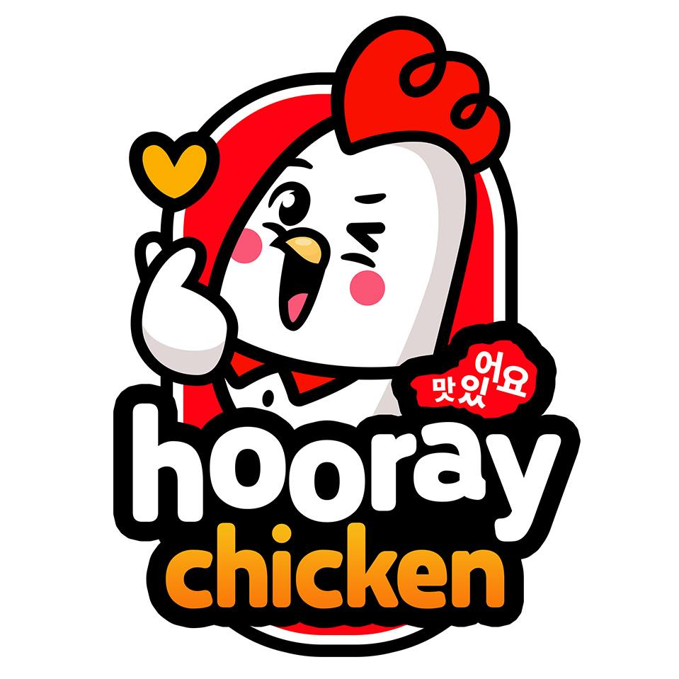

| Small Medium Enterprise (SME)
Food & Beverage (F&B): Profiling
What is a “Restaurant”?
Pain Points
A restaurant is a place where usually customer service is vital to serve their customers.
Food & drinks are usually served to you at your table by a waiter or waitress.
Scenario / Example:
The restaurant uses the traditional ordering method (writing with paper) and passes the order to the kitchen. Unfortunately, they encountered many wrong orders, and the food went to waste. Also, sometimes the staff tend to serve the food to the wrong table.
Customer management.
Human error.
Inventory management.
Food wastage.
Solutions
QR Order & Pay
Membership
Beep Delivery.
Recommended POS: iMin Falcon 1 | Sunmi D3/| iPad
Supplementary Devices : Cash Drawer, External Printers, Router, Bixolon Printer (if needed)
POS = Point of Sales | BO = BackOffice | QR = Quick Response
Notes:
MY- Elcantina
PH- Hooray Chicken
TH - Meat Lover

Slide 8

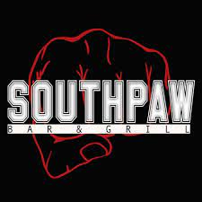

| Small Medium Enterprise (SME)
Food & Beverage (F&B): Profiling
What is a “Bar”?
Pain Points
Bar is a business where alcoholic drinks such as beers, wine, or liquor are served.
The primary objective of bars is to provide you with as many different alcoholic drinks or liquors.
They also offer snacks and some may even provide food from the dinner menu.
Scenario / Example:
The mix club's customers randomly order beers/liquor bottles, and the staff tend to miss out on the orders as there would be multiple orders. Also, most of the time the sales do not tally with the inventory.
Customer engagement.
Inventory management.
Fewer staff.
Food wastage.
Messy sales tracking.
Sales total does not tally.
Solutions
QR Order & Pay
Membership
Beep Delivery.
Recommended POS: iMin Falcon 1 | Sunmi D3/| iPad
Supplementary Devices : Cash Drawer, External Printers, Router, Bixolon Printer (if needed)
POS = Point of Sales | BO = BackOffice | QR = Quick Response
Notes:
MY- The Mix Club
PH - Southpaw
TH- Hollywood

Slide 9


| Small Medium Enterprise (SME)
Food & Beverage (F&B): Profiling
What is a “Food Truck”?
Pain Points
Food Truck is a mobile restaurant equipped with small kitchen to cook, prepare and serve food directly to their customers
Customers usually orders directly at the food truck and picks up the order once its done
Scenario / Example:
The food truck owner has no POS system, he sometimes faces issues with order management. He often complains about the messy sales tracking. Also, he tends to miss out on customers' orders and can’t keep track of customer details
Order management.
Can’t keep track of their customer’s details.
Messy sales tracking.
Long queue.
Cash does not tally.
Solutions
QR Order & Pay
Membership
Beep Delivery.
Recommended POS: iMin Falcon 1 | | iPad
Supplementary Devices : Cash Drawer, External Printers, Router, Bixolon Printer (if needed)
POS = Point of Sales | BO = BackOffice | QR = Quick Response
Notes:
MY- The Mac
TH - Captain PIZZA

Slide 10
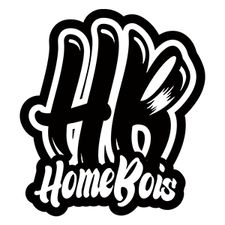

| Small Medium Enterprise (SME)
Food & Beverage (F&B): Profiling
What is a “Food Court”?
Pain Points
Food court (or also called a food hall or hawker center) is generally an indoor plaza or common area within a facility that is contiguous with the counters of multiple food vendors and provides a common area for self-serve dinner / lunch / or sometimes breakfast.
A dining area for public
Scenario / Example:
This particular food court has fewer staff and a centralized old cash box that the owner manages. As a result, customers would need to go to two stations (one at the stall for food ordering and another at the centralized counter to pay). Sometimes, the queue tends to be long, and it takes a lengthy time to prepare and serve the food to the customers too.
Order Management
Can’t track customer details
Fewer staff
Human error (wrong orders)
Inventory Management
Solutions
QR Order & Pay
Membership
Recommended POS: iMin Falcon 1 | Sunmi D3/| iPad
Supplementary Devices : Cash Drawer, External Printers, Router, Bixolon Printer (if needed)
POS = Point of Sales | BO = BackOffice | QR = Quick Response
Notes:
MY- Homebois Pitstop, Food district

Slide 11

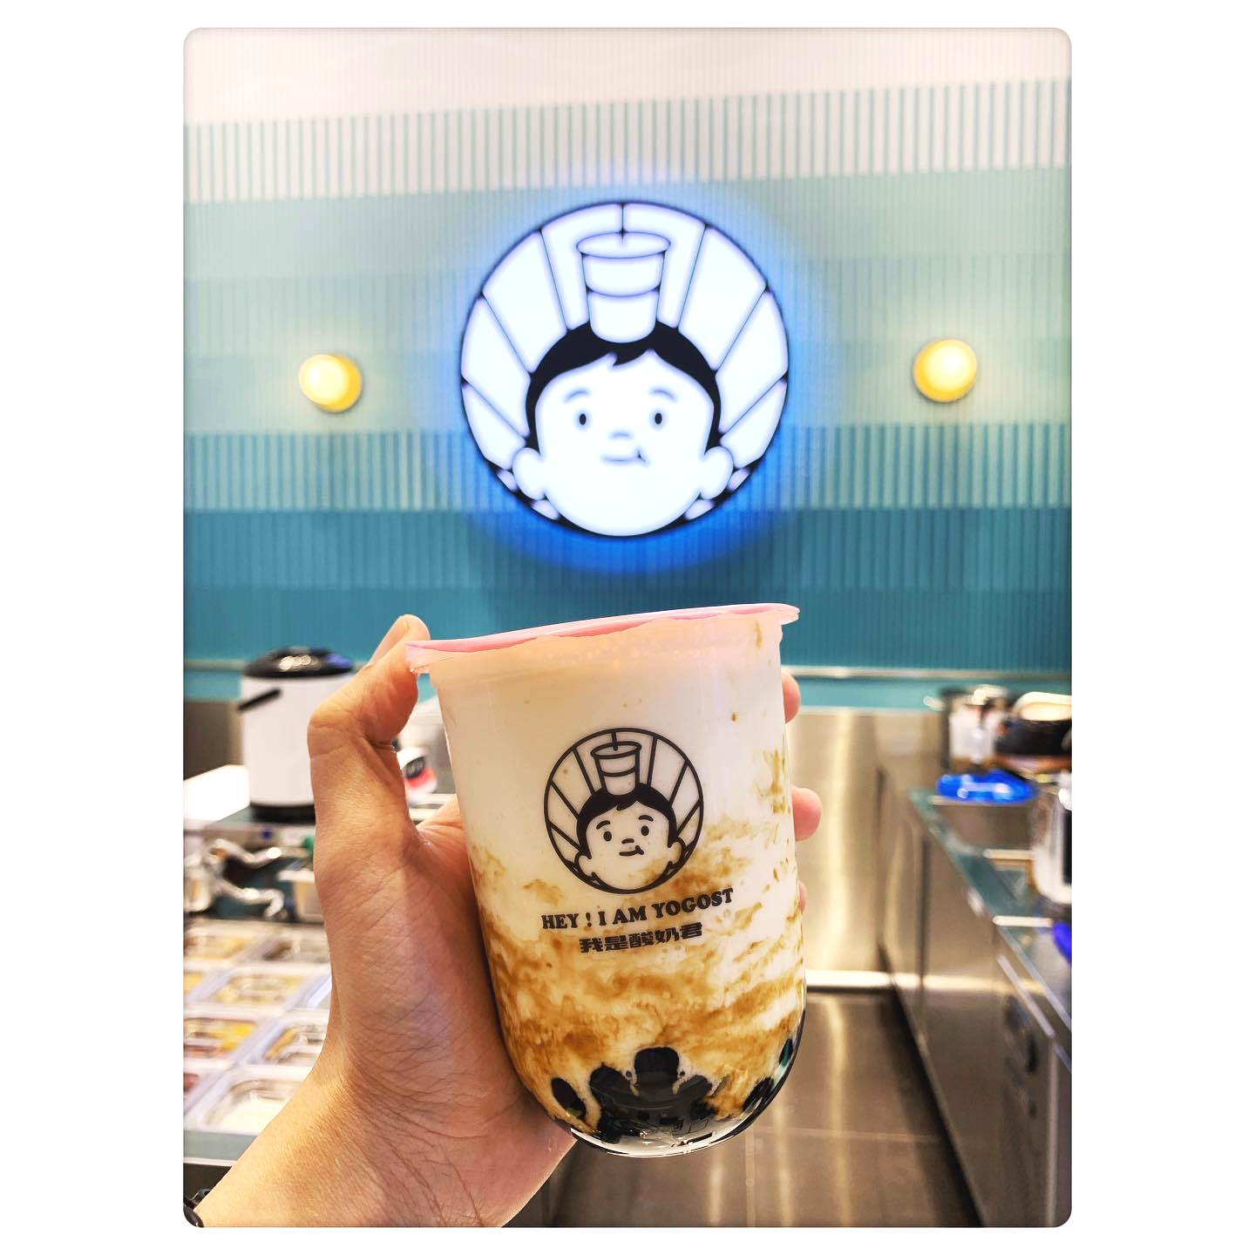
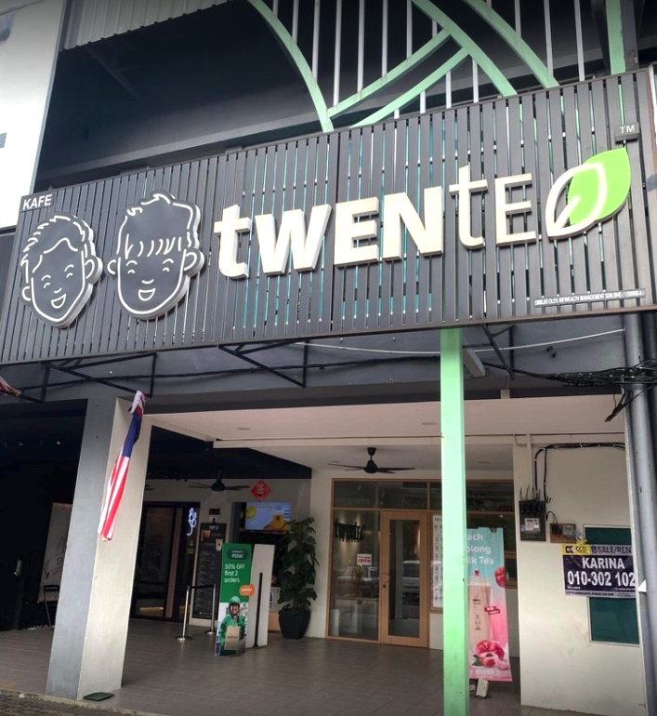
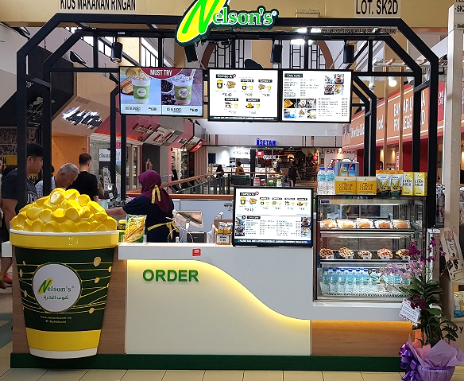
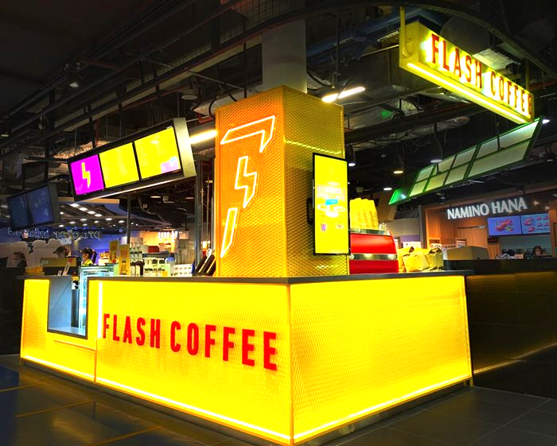
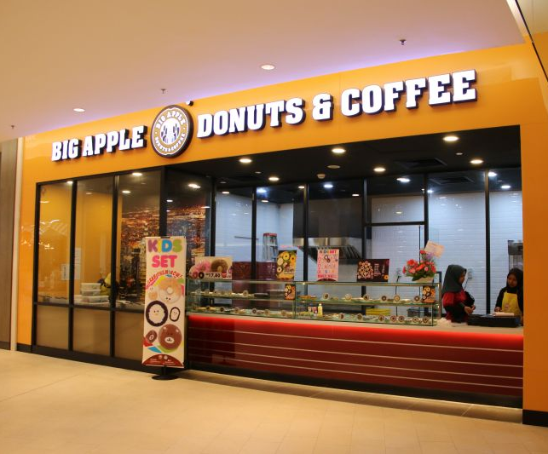
| Small Medium Enterprise (SME)
Food & Beverage (F&B): Franchises
To sell a product or provide a service under the name of a business, a franchisee obtains a licence from the franchisor.
The franchisee usually pays the franchisor an initial start-up and annual licence fee.
Examples of F&B franchisees using StoreHub:
I Am Yogost
Twentea
Nelson’s
Flash Coffee
Big Apple

Slide 12
| Small Medium Enterprise (SME)
Food & Beverage (F&B): Common Objections (Pricing)
Why do I have to Pay a Subscription?
Merchants can be weary of subscription-based services as it eats into their margins for the long run
Unlike equipments, they pay for installments which will eventually be settled, and they own that piece of hardware.
Remember that our BackOffice is entirely cloud-based and the servers used to store sales data, menus, and customer info cost StoreHub maintenance fees.
In our yearly software plan, these also includes Customer Care support we provide (9.00AM to 9.00PM), future feature upgrades and we do not charge for Care Support that we provide via LiveChat/Email or Phone calls.

Slide 13
| Small Medium Enterprise (SME)
Food & Beverage (F&B): Common Objections (Pricing)
Why are StoreHub’s packages so expensive?
The estimated price range above applies only for the first year of signing up because it combines both SW plan & the HW amount.
But for the following year, Hardwares are one-off purchase and it is for you to keep as long your business is operating. As for the Software, you just have to renew the plan you sign up with us
StoreHub remains as one of the leading POS providers in the market and we’re always developing new features to help streamline the Merchants business.
Existing features for F&B Merchants include QR Order and Pay, Beep Delivery, Membership, Engage, Multiple Beer Dockets, and more

Slide 14
| Small Medium Enterprise (SME)
Food & Beverage (F&B): Common Objections (Features)
Merchants may ask for F&B related features such as Expiry Tracking, Reservation or Booking, etc.,
Ask the customer why they need the feature and what is the problem they are trying to solve (e.g Why are you looking for a booking system? What’s the use case for this in your operations?
After finding out the problem identify if the customer already has an existing solution for the problem
Determine if the solution to the problem is a deal breaker or just a mild inconvenience (e.g How will this affect your business if you do not have this implemented?)
If the feature required is a deal breaker, find out the best workaround solution
If the customer agrees with the workaround, proceed with the solution.
If not, redirect the customer as to the trade off that customer is making
If the feature required is not a deal breaker and just to solve a mild inconvenience, refocus the customer’s attention on the main value propositions of the solution.

Slide 15
| Small Medium Enterprise (SME)
Food & Beverage (F&B): Common Objections (Short-Term Loans)
Merchants may attend events like bazaars and festivals – so they only want to use our system for a certain duration
First check if the customer needs this for their physical store or for their event based business?
How often is their event?
Our subscription runs on a monthly and yearly basis and this might be added cost for you if you're only using it for a few days.This Software subscription does not include yet the Hardware packages. Share website to merchant
Note: StoreHub is not suitable for event/bazaar type of business as we run on monthly/yearly subscription (check if merchant has a physical shop instead)

Slide 16
| Small Medium Enterprise (SME)
Food & Beverage (F&B): Common Objections (Order Taking Flow)
Merchants sometimes want waiters to take orders at tables using a mobile device. This device syncs to the main system and order immediately goes through to the kitchen.
StoreHub is able to cater to this using the Multiple Register Sync (MRS) feature, and use iPads to take orders.
However, we do not sell iPads – Merchants must obtain an iPad on their own (Gen 6 and above, and cannot be a Mini or Air model)
You can also note that this feature requires a stable internet connection – StoreHub offers specially-configured routers (Mikrotik) for this purpose.

Slide 17
| Small Medium Enterprise (SME)
Food & Beverage (F&B): Common Objections (Order Taking Flow)
Merchants may also want offline ordering perhaps due to their location’s weak network infrastructure.
We always recommend stable internet connection for our devices to work, because our BackOffice is a cloud-based platform afterall.
However, Merchants can use their systems offline for up to 30 days without losing data. But they must sync their sales data at the 30th day to have it all reflect on their BackOffice.

Slide 18
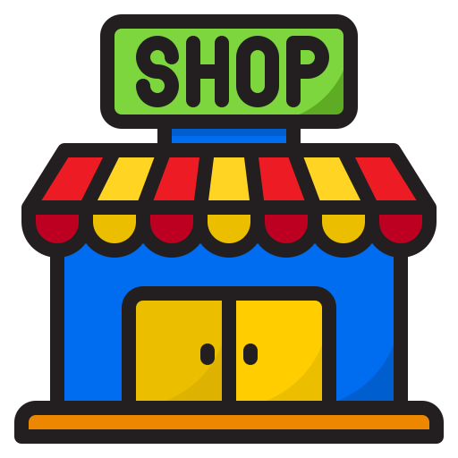


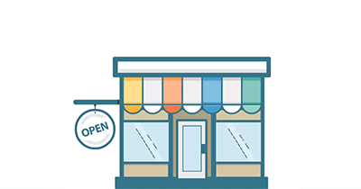
| Small Medium Enterprise (SME)
Retail: Overview
Retail is defined as the sale of goods or services by a business to an individual consumer for personal use.
Offline
Online (Ecommerce)
Fashion
Grocery
Websites
Social Media
Marketplace
Wholesaler
Wholesale Mall

Slide 19
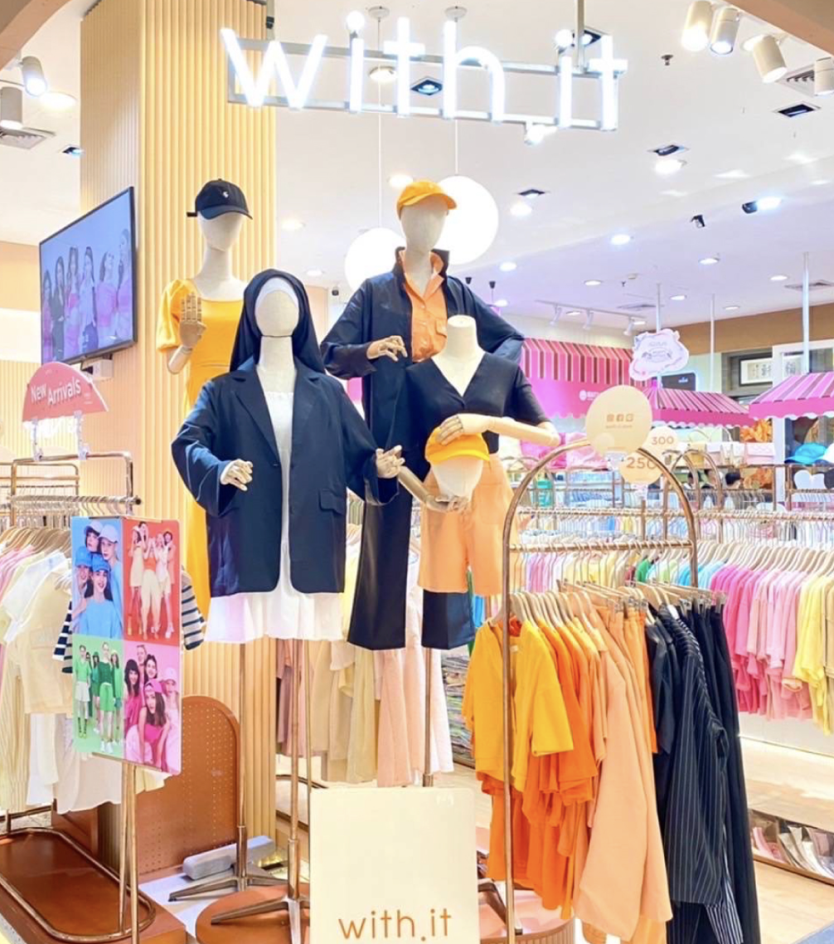
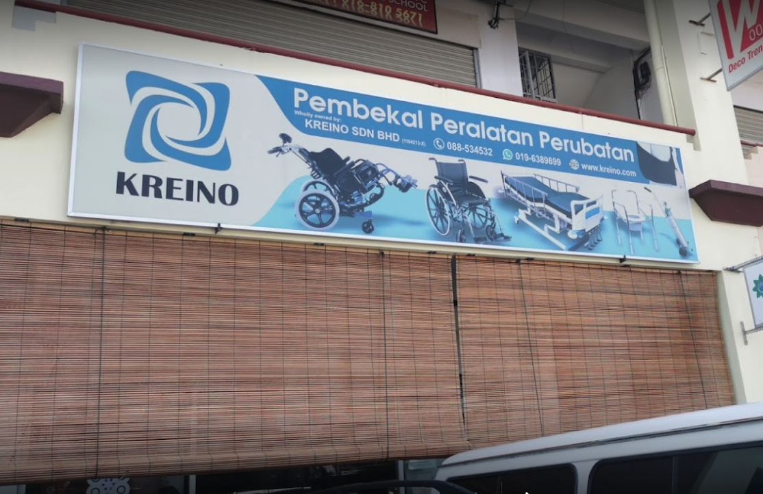
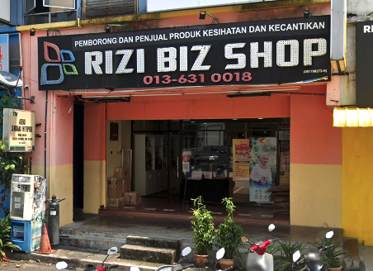
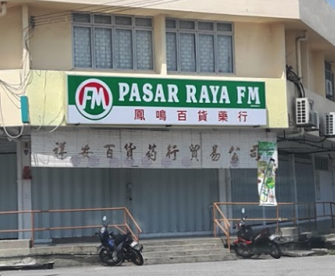
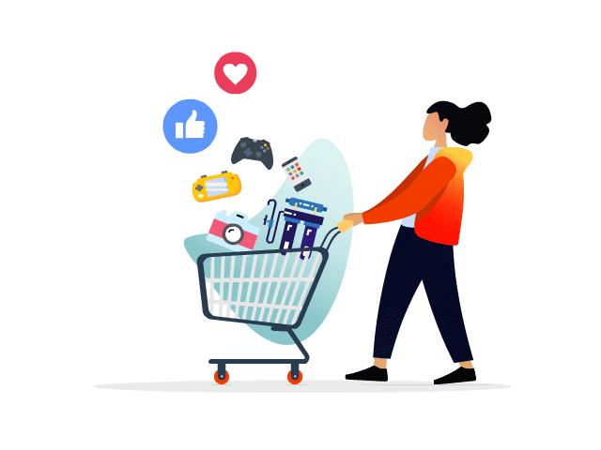
| Small Medium Enterprise (SME)
Retail: Offline
An offline retailer is a retailer that sell products through a store front location in-person.
Examples of offline retailers using StoreHub:
Customer Journey
Customer enters the store.
Customer exits the store.
Customer selects the item.
Customer makes payment at cashier counter.
Boutique
Medical Supplies
Beauty Supplies
Grocery Store

Slide 20
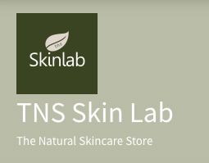



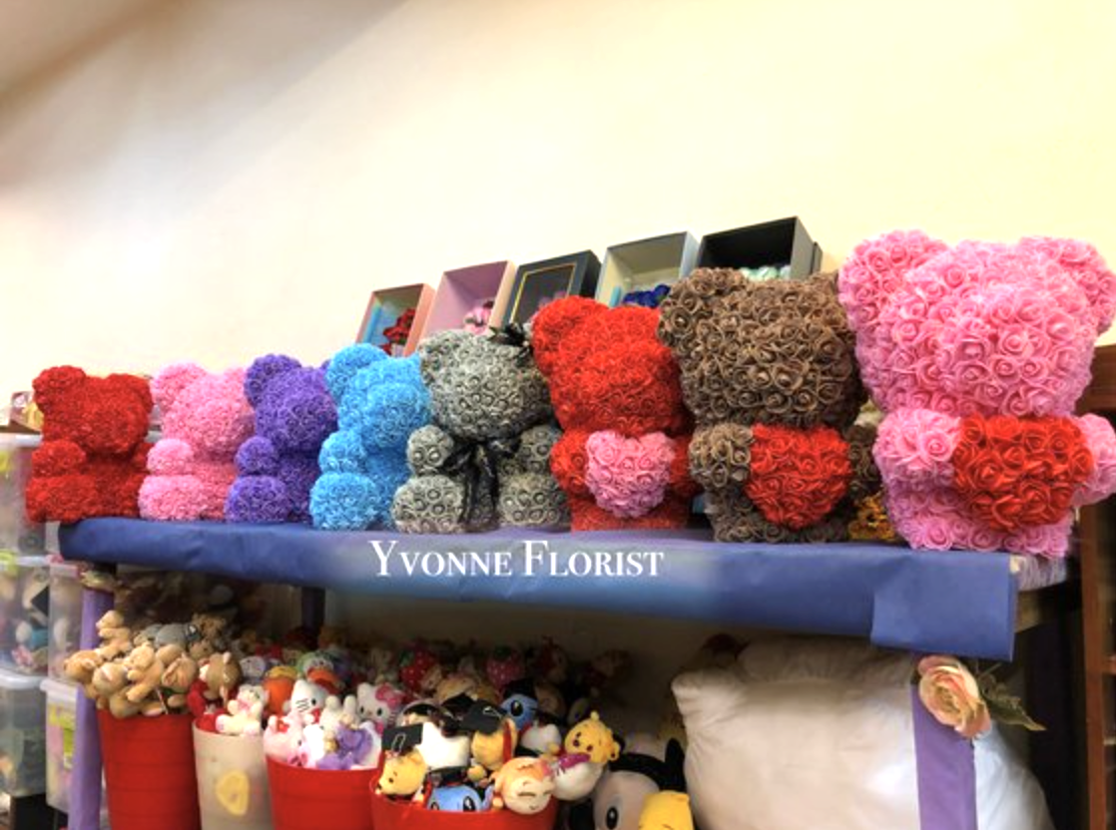



| Small Medium Enterprise (SME)
Retail: Online
Electronic retailing is the sale of goods and services through the internet. It can include business-to-business (B2B) and business-to-consumer (B2C) sales of products and services.
Examples of online retailers using StoreHub:
Customer Journey
Customer visits the website / online stores.
Customer check out & makes payment online.
Customer looks for an item.
Customer compare items from various websites.
Customer adds product to shopping cart.

Slide 21
| Small Medium Enterprise (SME)
Retail: Online - Types of Online Platform
While the term "ecommerce" is frequently used to refer to the online sale of physical products, it can also refer to any type of commercial transaction facilitated by the internet.
Website
Marketplace
Social Media

Slide 22
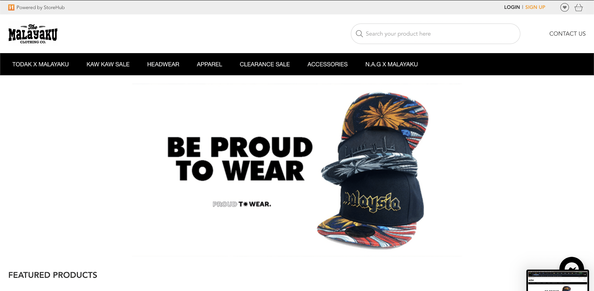
| Small Medium Enterprise (SME)
Retail: Online - Types of Online Platform (Website)
Website is the preferred platform for the majority of retailers.
Merchants have the opportunity to showcase their products.
Complete control over the appearance of the merchant's website.
Merchants can select their own domain name.
Website
https://themalayaku.com

Slide 23
| Small Medium Enterprise (SME)
Retail: Online - Types of Online Platform (Website) (cont.)
Domain Name
The domain name is the address of a website that end users type in the URL bar of their browser to access it.
Web Hosting
Web hosting is the location where your website's data is stored.
Web hosts includes .com, .net, .org and etc.
If a merchant wishes to host their domain under .com or .net, they will be charged a fee. While merchants will be able to use storehub.me for free.
Website

Slide 24
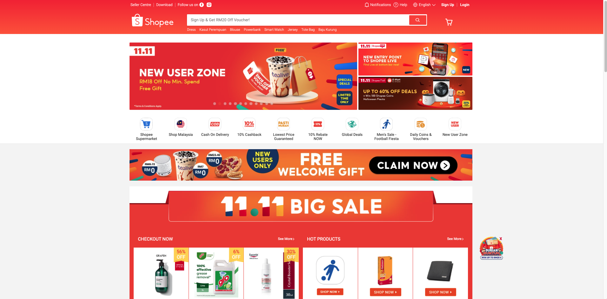
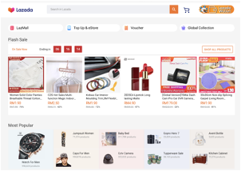
| Small Medium Enterprise (SME)
Retail: Online - Types of Online Platform (Marketplace)
Occurs on online marketplaces that connect merchants and customers.
Provides buyers and sellers a platform to do business.
Shopee, Tokopedia and Lazada are popular marketplaces in South East Asia. Source
Marketplace
https://shopee.com

Slide 25
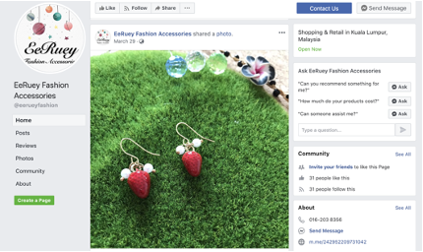
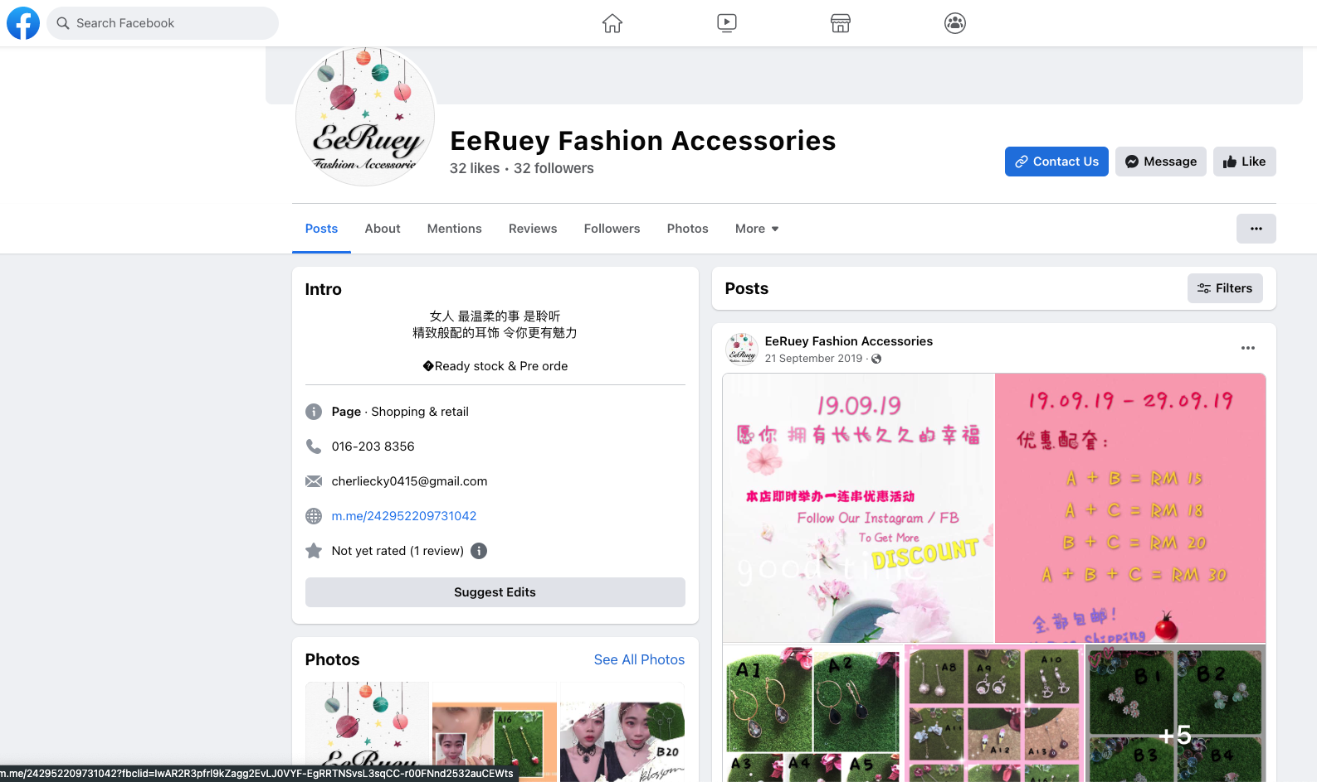
| Small Medium Enterprise (SME)
Retail: Online - Types of Online Platform (Social Media)
Merchants frequently use social media platforms such as TikTok, Facebook and Instagram to market and sell their products.
Merchants does not need to pay any fees to publish their products, however they may incur fees for every products sold on the platform.
Social Media
https://www.facebook.com/eerueyfashion

Slide 26
| Small Medium Enterprise (SME)
Retail: Online - Types of Online Platform (Social Media) (cont.)
Customer Journey
Customer browse for the products / stumbleupon ads.
Seller ships out product to customer.
Social Media
Customer message seller / screenshot image to show seller.
Seller confirms payment received.
Seller advices customer on payment method.
Customer makes payment & providing proof of payment.

Slide 27
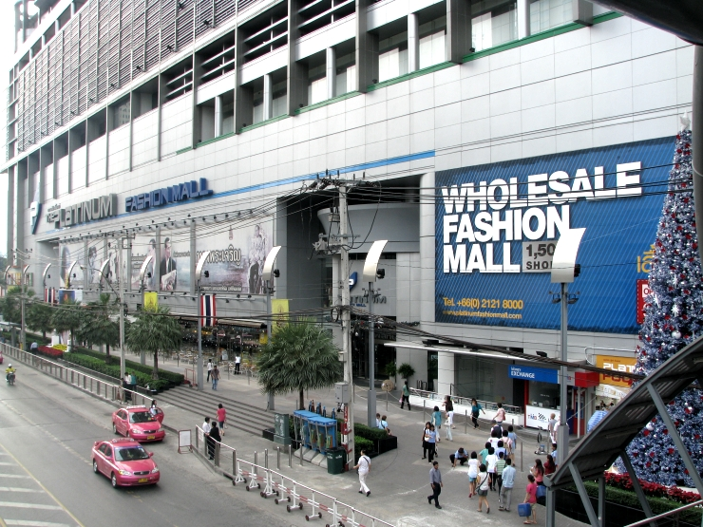
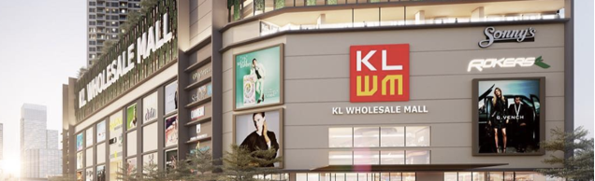
| Small Medium Enterprise (SME)
Retail: Wholesaler
A wholesaler is a person or company who sells products in bulk to various outlets or retailers for onward sale, either directly or through a middleman
In a wholesaler relationship / transaction, usually it will involve 4 mains important areas / documents:
Credit Terms
Invoice
Delivery Order
Purchase Order
https://platinumonline.platinumfashionmall.com/

Slide 28

| Small Medium Enterprise (SME)
Retail: Wholesaler (cont.)
Credit Terms
Payment terms for a company's sales invoice (which the customer will refer to as a purchase invoice).
The credit terms also state whether a discount is available for faster payment (the discount period).
Example:
Net due upon receipt.
Net 30 days (which means the amount owed is due in 30 days).
Invoice
A commercial document that details and records the terms and conditions of a transaction between a buyer and a seller.
Delivery Order
A document that can be issued by the owner of freight, consignee, shipper or a carrier to deliver the goods to another party.
Purchase Order
A written agreement between a purchaser and a supplier authorising a purchase.

Slide 29
| Small Medium Enterprise (SME)
Food & Beverage (Retail): Common Objections (Price)
Why do I have to Pay a Subscription?
Merchants can be weary of subscription-based services as it eats into their margins for the long run
While Retail Merchants do not pay a lot for equipment, they do have to spend a lot on keep stocks in season, deal with faulty products, and fees for inventory spaces.
Remember that our BackOffice is entirely cloud-based and the servers used to store sales data, menus, and customer info cost StoreHub maintenance fees.
In our yearly software plan, these also includes Customer Care support we provide (9.00AM to 9.00PM), future feature upgrades and we do not charge for Care Support that we provide via LiveChat/Email or Phone calls.

Slide 30
| Small Medium Enterprise (SME)
Food & Beverage (Retail): Common Objections (Pricing)
Why are StoreHub’s packages so expensive?
The estimated price range above applies only for the first year of signing up because it combines both SW plan & the HW amount.
But for the following year, Hardwares are one-off purchase and it is for you to keep as long your business is operating. As for the Software, you just have to renew the plan you sign up with us
StoreHub remains as one of the leading POS providers in the market and we’re always developing new features to help streamline the Merchants business.
Existing features for Retail Merchants include free Webstore, SKU tracking, Barcode scanning, Store Credit, customisable promotions, and more.

Slide 31
| Small Medium Enterprise (SME)
Food & Beverage (Retail): Common Objections (Short-Term Loans)
Merchants may attend events like pop-up markets and festivals – so they only want to use our system for a certain duration
First check if the customer needs this for their physical store or for their event based business?
How often is their event?
Our subscription runs on a yearly basis and this might be added cost for you if you're only using it for a few days.This Software subscription does not include yet the Hardware packages. Share website to merchant
Note: StoreHub is not suitable for event/bazaar type of business as we run on yearly subscription (check if merchant has a physical shop instead)

Slide 32
| Small Medium Enterprise (SME)
Food & Beverage (Retail): Common Objections (Feature)
Merchants may want features such as a weigh scale integration, invoice or quotation, full credit term payments and more.
Ask the customer why they need the feature and what is the problem they are trying to solve (e.g Why are you looking for a weighing scale integration? What’s the use case for this in your operations?
After finding out the problem identify if the customer already has an existing solution for the problem
Determine if the solution to the problem is a deal breaker or just a mild inconvenience (e.g How will this affect your business if you do not have this implemented?)
If the feature required is a deal breaker, find out the best workaround solution
If the customer agrees with the workaround, proceed with the solution.
If not, redirect the customer as to the trade off that customer is making
If the feature required is not a deal breaker and just to solve a mild inconvenience, refocus the customer’s attention on the main value propositions of the solution.

Slide 33
| Small Medium Enterprise (SME)
Food & Beverage (Retail): Common Objections (Multi-Channel Selling)
Merchants may want to sell their existing inventory on ecommerce platforms (Shopee/Lazada)
We currently offer a Webstore for Advanced and Pro plans and it’s free to use.
This is basically a website they can use to sell their items. The platform comes with a template and items can be added or adjusted via the BackOffice.
Merchants do not have to pay to create and list on their Webstore, but they have to pay StoreHub a transaction fee for every purchase completed.
There is no marketplace integration with 3rd party platforms like Shopee and Lazada yet.

Slide 34

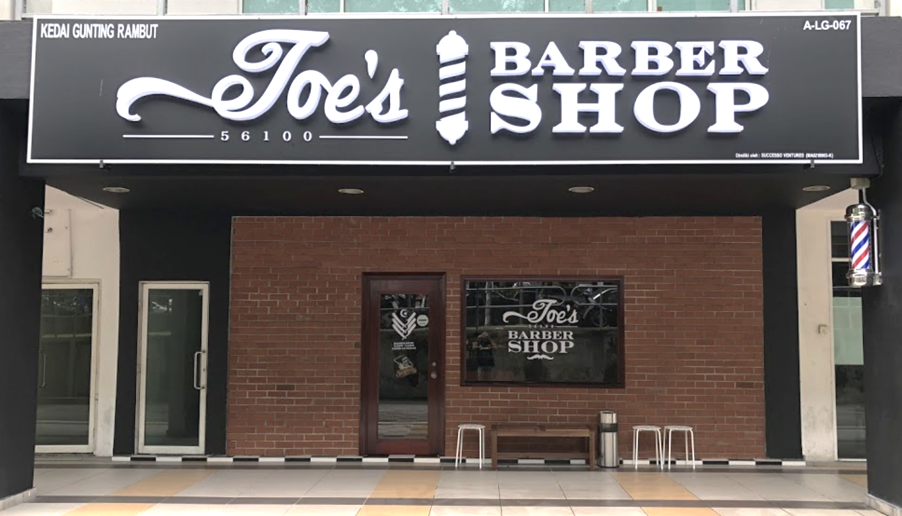
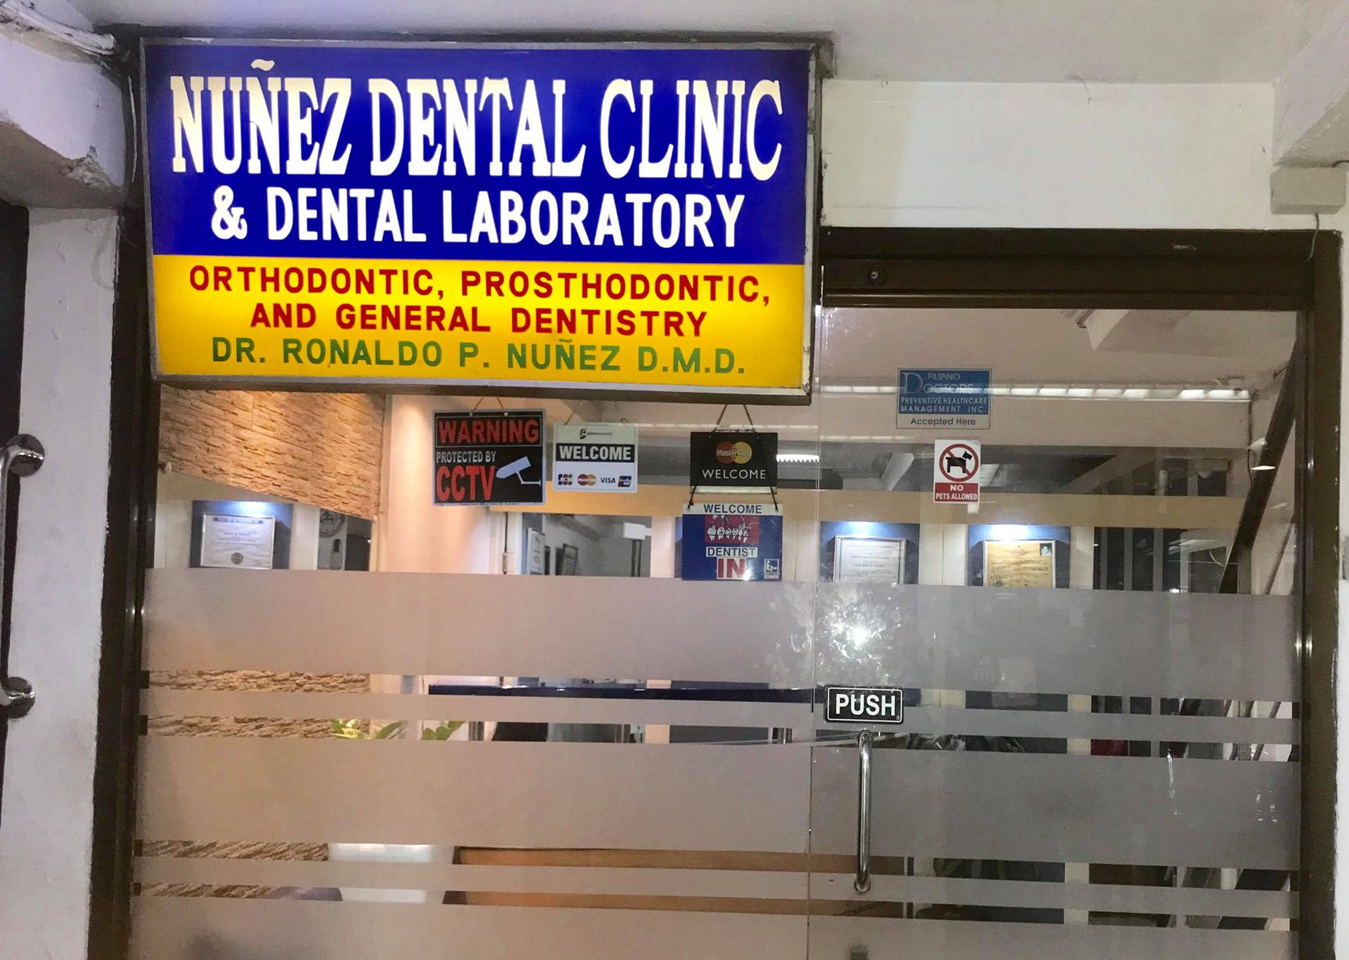
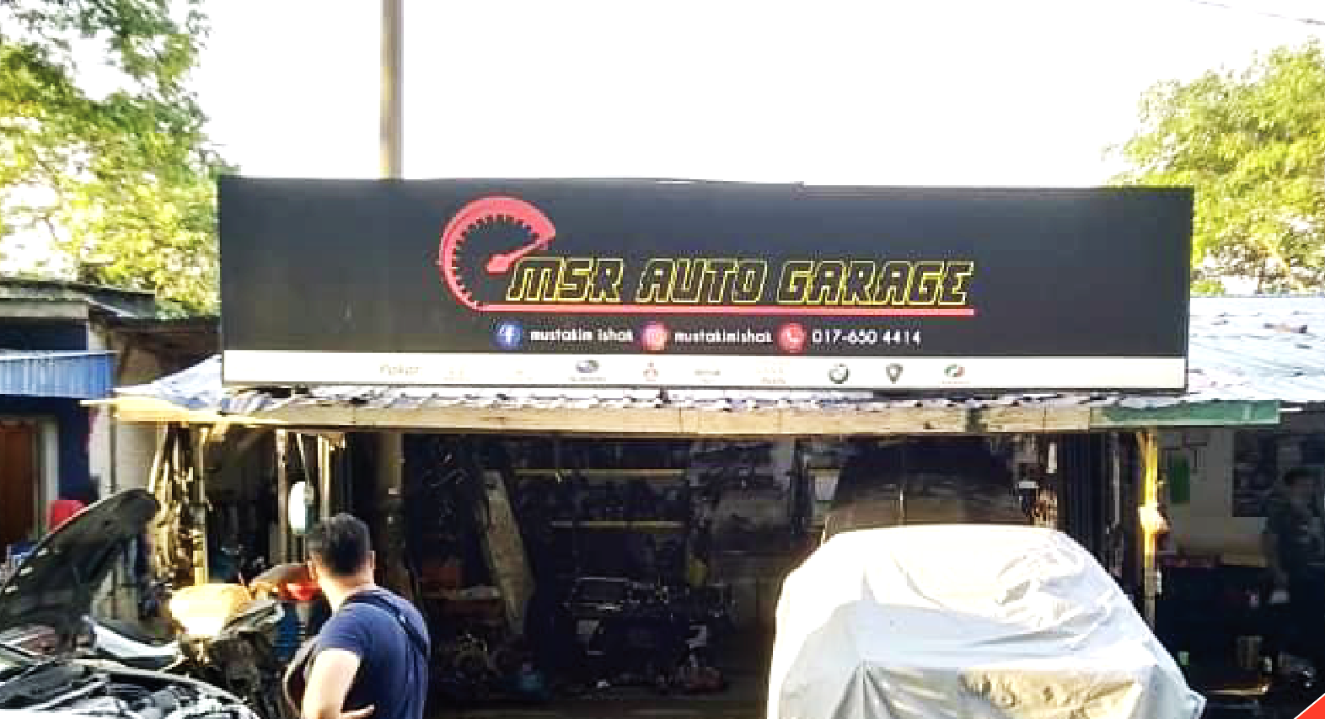
| Small Medium Enterprise (SME)
Services: Overview
When a merchant sells an act of service to the customer rather than physical goods, this is referred to as service retailing.
Examples of services merchants using StoreHub:
Barber Shop
Dental Clinic
Car Workshop

Slide 35
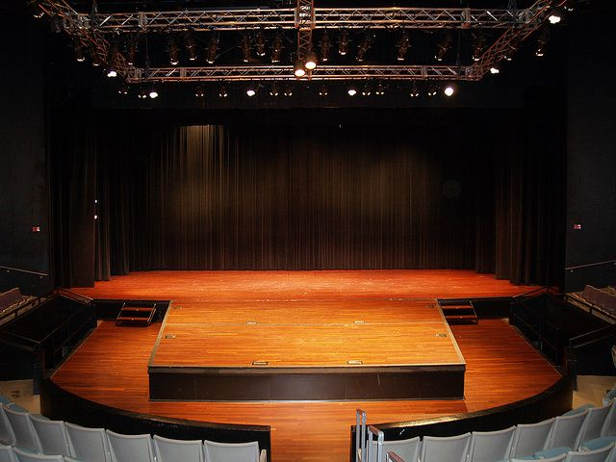

The Platform for Awesome Businesses
The End
THIS DOCUMENT IS STRICTLY PRIVATE AND CONFIDENTIAL. THIS IS INTENDED FOR INTERNAL USE ONLY; DO NOT CIRCULATE
Copyright © 2023 StoreHub. All rights reserved. No parts of this document can be reproduced, distributed, transmitted or stored electronically without StoreHub’s prior written permission.
21

